Slide 1
LI&R VALUATIONS semester 2, 2020

Slide 2
Tutorial 3
M14: CAPITAL

Slide 3
CONTENT
Tutorial topics
Online exams
Learning objectives
Exercises

Slide 4
Topics – S2 2020
Tutorial | Date | Outline
1 | 1 July | Orientation and course overview
2 | 23 Jul | M5 & M6 spreadsheets
3 | 6 Aug | M14 Capital
3 | 20 Aug | M12 Analysis of Surplus
4 | 27 Aug | M15 AV
5 | 3 Sep | Revision & Exam Technique
5 | 17 Sep | Revision & Exam Technique
Notes:
Any areas that you would like covered again?

Slide 5
Learning objectives
Notes:
Announcement
Overseas study groups.
Where are people located?

Slide 6
Learning objectives
7 Analyse a risk-based capital model for a life insurer or retirement fund
7.1 Explain the need for capital
7.1.1 Examine the purpose of capital
7.1.2 Consider the impact of an entity’s financial strength on its stakeholders
7.1.3 Explain the benefits of a risk-based approach to calculating capital
7.1.4 Contrast regulatory and economic capital
7.2 Evaluate an entity’s capital requirements under a three pillar approach
7.2.1 Examine the three pillar approach to quantifying, qualifying and reporting on risk-based capital
7.2.2 Explain the different types of capital that can be used by entities
7.2.3 Analyse the range of risks faced by an entity and their impact on the entity’s capital requirements
7.2.4 Examine the adjustments to asset and liability values that may be required in determining a company’s capital base
7.2.5 Calculate an entity’s capital base and its prescribed capital amount, using a range of risk assessment and aggregation techniques
7.3 Consider the implications of capital adequacy standards for a life insurer or retirement fund
7.3.1 Examine components of the internal capital adequacy assessment process
7.3.2 Explain the role of the regulator under a three pillar capital approach
7.3.3 Explain the role of disclosure under a three pillar capital approach

Slide 7
M14: The theory

Slide 8
Introduction
Objective is to meet liabilities as they fall due.
Purpose of the valuation drives methods and assumptions. Strength of the valuation basis determines the PV liabilities and provides a certain level of confidence that assets will be sufficient to cover liabilities.
This module is attempting to answer the question
“What value of assets is required to cover liabilities with a stated level of confidence, if actual experience is much worse the expected within a stated time horizon?”
A stressed scenario can impact on either side of the balance sheet.
Risk are defined in Module 13 (Risks Management) and are broadly classified as
financial (insurance, credit, market, liquidity)
non-financial (operational, strategic, application/execution)
Includes upside and downside

Slide 9
Balance Sheet view
Capital is defined as the amount by which assets exceed liabilities.
Capital
Liabilities
Assets

Slide 10
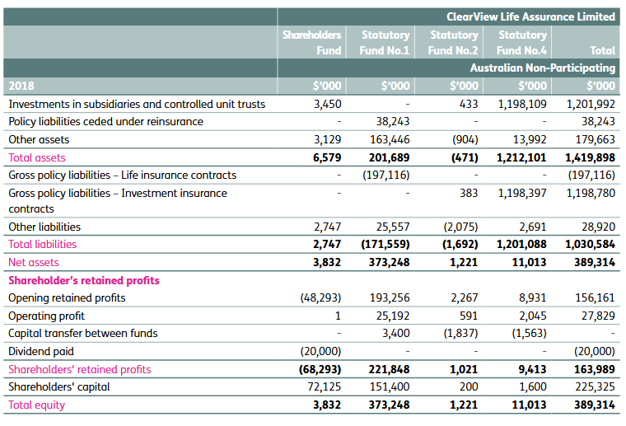
Clearview – financial position
Source: Clearview Annual Report 2018 https://www.clearview.com.au/documents/shareholder-reports/FY-2018-Annual-Report

Slide 11
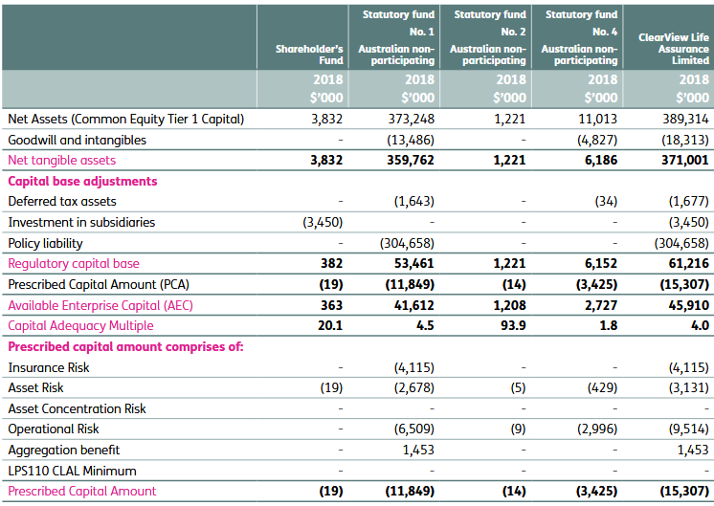
Clearview - capital position
Source: Clearview Annual Report 2018 https://www.clearview.com.au/documents/shareholder-reports/FY-2018-Annual-Report
Notes:
Tier 1 capital (CET1 and AT1)
Net Assets – Tier 1 capital. Highest quality. Can be used to absorb losses without ceasing operations. Tier 2 is lower quality, less reliable and may have a limited life and/or ongoing servicing obligations.
Paid-up ordinary shares and retained earnings. CET1 is subordinared to other forms of funding (lowest priorty in winding-up). Absorbs losses when they occur, full flexibility of dividend payments and no maturity date.

Slide 12
Regulatory Adjustments
Regulator imposes some restrictions on an insurer’s capital base. i.e. what capital can count as capital for solvency.
Difference assumptions and methods to place values on assets and liabilities impact the disclosed value of capital. It is therefore necessary to alter the value of assets and liabilities when recognizing the value of capital.
Adjusted asset values (see page 28 of M14)
The balance sheet is on a going concern basis and includes intangible assets such as deferred tax.
Regulator view for determining the capital base is a gone concern basis, i.e. wind up.
Example removing deferred tax assets as these cannot be recognized in wind up.
Adjusted liability values (see page 29 of M14)
Objective is to separate policy owner interests and shareholder interests.
Example: removal of shareholder profits from policy liabilities and adjust the capital base for the difference. The difference can be positive or negative.

Slide 13
Prescribed capital amount
PCA is defined as the sum of:
capital to cover:
insurance risk (mortality, longevity, morbidity, lapses, expenses);
market risk (including mismatch risks between assets and liabilities);
credit risk;
liquidity risk;
operational risk; and
other risks identified by the entity; less
an aggregation benefit; plus
a combined stress scenario (CSS) adjustment.

Slide 14
Measuring stresses
The PCA is set at a level such that there is only a small probability, 0.5%, say, that a company will incur a loss greater than the PCA over the selected time horizon.
This is an example of a ‘Value at Risk’ (VaR) method of setting capital requirements.
Notes:
Confidence levels: PL on BE basis – reserves will be sufficient 50% of the time. 99.5% confident can withstand shocks and have enough assets to cover liabilities at the end of the year. CL related to the specific shocks. Value at risk method at confidence level (1 in 200)
Time Horizon: Capital adequacy for a life insurer is usually measured over a specific time horizon, such as one year. This time horizon allows for delays between a stressed situation emerging and the ability of a company and/or its regulator to respond to the situation.

Slide 15
Insurance risk example
At a high level, factors that create insurance risk may be classified into:
mortality (increasing mortality rates that cause losses, such as in term insurance);
longevity (decreasing mortality rates that cause losses, such as in annuity contracts);
claim inception rates for morbidity contracts;
claim termination rates for morbidity contracts with regular payments;
lapse rates;
expenses split by acquisition, maintenance and termination;
take-up rates of guarantees or options, such as:
guaranteed annuity factors in deferred annuities with cash options (see Module 2 (Cashflows));
extension of a term insurance;
increasing sum insured on marriage or birth of dependants; and
other material risks. For example, policy paid-up rates may be important in some jurisdictions.

Slide 16
Mortality and morbidity risk
Four risk components applied to mortality and morbidity risk:
Random stresses (also called volatility)
Catastrophe
Trend uncertainty
Level uncertainty

Slide 17
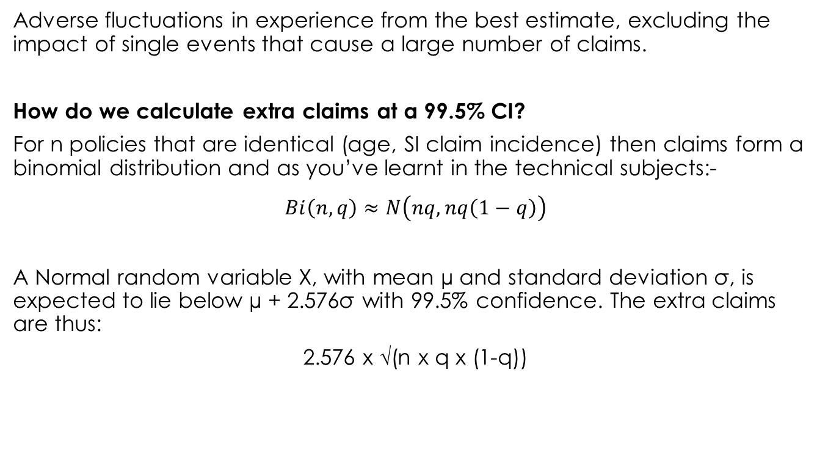
Random stresses
Adverse fluctuations in experience from the best estimate, excluding the impact of single events that cause a large number of claims.
How do we calculate extra claims at a 99.5% CI?
For n policies that are identical (age, SI claim incidence) then claims form a binomial distribution and as you’ve learnt in the technical subjects:-
$$Bi\left(n,q\right)≈N\left(nq,nq\left(1−q\right)\right)$$
A Normal random variable X, with mean µ and standard deviation σ, is expected to lie below µ + 2.576σ with 99.5% confidence. The extra claims are thus:
2.576 x √(n x q x (1-q))
Notes:
Assuming (1-q) is very close to 1 (i.e. the claim incidence rate q is very small), the extra claims as a proportion of the best estimate number of claims can be approximated by 2.576 / √(n x q)
In practice, a life company’s policies are likely to have a skewed distribution of sums insured. A small proportion of policies will have very large sums insured. In addition, best estimate mortality rates will vary by age, sex, smoking status and other rating variables. The claims costs will not have a binomial distribution and stochastic modelling may be necessary to determine the random stress margins. The random stress will decrease as the number of policies, of similar riskiness, increases. The random stress will increase as the skewness of the distribution of sums insured increases

Slide 18
Catastrophe stresses
This stress extends the random stress event to allow for the impact of a single event causing multiple claims in some timeframe, usually the capital calculation time horizon, following the reporting date.
It is difficult to model this type of risk due to the lack of available data.
Example: increase in mortality of 0.5 per mille for two years.
same at all ages
same regardless of number lives insured
spread over a period that exceeds the time horizon
The pandemic scenario may apply to contracts that are impacted favourably by higher mortality rates
e.g. lifetime annuities
diversification but not a perfect correlation
Notes:
As an example, the Australian regulator has set the pandemic scenario with reference to the 1918 influenza pandemic (Spanish flu) that occurred over roughly a 12-month period during 1918 and 1919. Influenza normally affects mortality at young and old ages as well as weakened patients, but the Spanish flu killed mainly young, previously healthy adults. This pandemic spread around the world during a fairly short period. If a similar pandemic occurred now, its impact is expected to be much smaller, mainly due to advances in health care and the advent of antiviral drugs. However, others claim that the assumption that we are better equipped at dealing with such a pandemic is not justifiable as it is not obvious if we can treat an unknown pathogen.

Slide 19
Level and trend uncertainty
Other possible causes of variations in experience and assumptions for mortality and morbidity, e.g.
best estimate assumptions are incorrect (level uncertainty risk) or
allowances for future trends in mortality and morbidity experience (trend uncertainty risk)
Stress margins are applied for the term of the liabilities, e.g. multiple such as 1.2 applied to base tables)
Size will depend on the adequacy of the investigations used to determine the best estimate assumptions and the range of adverse factors that could affect trends in claims experience.
Notes:
Other examples of trends which might cause a deterioration in experience include diet and lifestyle factors, medical advances leading to improvements in diagnostic techniques that affect trauma claim rates, economic and social factors that affect income protection claims incidence and termination assumptions.

Slide 20
Questions

Slide 21
Exercise 1
Describe how the Value at Risk (VaR) approach may be used to evaluate the risk based capital requirement for a health and care insurance company. [10 marks]

Slide 22
Exercise 1 - Solutions
IFoA, ST1 exam 2017, April Q4
The VaR approach measures risk-based capital requirement based on a minimum required confidence level (e.g. 99.5%) [1½]
Over a defined period (e.g. one year). [¾]
The target percentage VaR could be determined by regulation/risk appetite/or to achieve a particular credit rating from rating agencies. [¾]
The supervisory balance sheet would typically be on a market consistent basis for this type of approach. [¾]
The assets and liabilities are subject to stress tests (or “shocks”) on each of the identified risk factors, at the defined confidence level and over the defined period. [1½]
The (market consistent) surplus is then recalculated at the end of the period. [¾]
Applying stress tests to each different risk factor gives a capital requirement for each separate risk in isolation. [1½]

Slide 23
Exercise 1 - Solutions
For a health insurance company, typical types of risk factor would include
Market risk [¼]
Interest rate risk [¼]
Credit risk [¼]
Persistency risk [¼]
Insurance risk (mortality) [¼]
Insurance risk (morbidity) [¼]
Catastrophe risk [¼]
Concentration risk [¼]
Risks attaching to firm’s pension scheme [¼]
Liquidity risk [¼]
Reinsurance risk [¼]
Group risk [¼]
Operational risk [¼]
Expenses risk [¼]

Slide 24
Exercise 1 - Solutions
In order to arrive at an aggregated capital requirement reflecting all risks, these need to be combined in a way which reflects any diversification benefits that exist between the various risks (i.e. the degree to which individual risks are correlated). [1½]
his may be done through the use of correlation matrices. [1½]
It should be noted that, under the extreme event conditions being tested, correlations may differ from those observed under “normal” conditions. [1½]
Alternatively, the aggregation approach may be done by copulas. [¾]
It should also be recognised that a combination of a certain subset of events happening at the same time, with an overall probability level of 1 in 200 (for example), may produce a higher capital requirement than combining all of the individual capital requirements for separate 1 in 200 events using a correlation matrix. [1½]
This is caused by the “non-linearity” of individual risks. [¾]
There could also be the “non-separability” of individual risks, which refers to the ways in which risk drivers interact with each other. [1½]
Separate allowance needs to be made in the capital requirement calculation for these effects. [¾]
Typically stochastic models are used to quantify the capital requirements in relation to economic risks. [¾]
The probability distribution used should properly reproduce the more extreme behaviour of the variable being modelled, both in the size of the tail of the distribution and, where appropriate, in the path taken during the simulation period. [1½]
For capital requirement projections, a “real world” asset model would typically be used and this should be arbitrage free. [¾]
It is generally appropriate to calibrate such models with reference to actual historic parameters. [¾]
However, advanced techniques may be required to ensure appropriate fit to the tail of a distribution, [¾]
To ensure that the distributions do not understate the frequency of more extreme outcomes. [¾]
Modelling techniques for short-term and for long-term business may be different [¾]

Slide 25
Exercise 2
You are one of the Principals of a small actuarial consulting firm. It is early 2019 and you have recently won the engagement to become the external Appointed Actuary of (and provide actuarial services to) ABC Life, a wholly-owned subsidiary of global insurance company PQR Insurance. ABC Life writes retail investment-linked superannuation business into its only Statutory Fund, with these products open to new members.
PQR Insurance is keen to grow its business and is exploring entering the retail risk insurance market via ABC Life’s existing retail superannuation business. As a result, ABC Life has decided to develop a fully underwritten retail life insurance offering. To begin with, ABC Life plans to:
Only provide death benefits, with no coverage for disability benefits.
Enter into a 20% quota share reinsurance arrangement.
ABC Life has a small internal actuarial function, so has asked for your assistance in projecting the amount of capital required to support the new death benefit offering.
Your key contact at ABC Life is the newly appointed Chief Financial and Operating Officer (CFOO), who has an extensive finance background at a major bank but has never worked in insurance. The CFOO has mentioned that he recently attended a 2 day life insurance conference organised by the life insurance and wealth management industry body, where he heard a range of presentations including one about regulatory capital.

Slide 26
Exercise 2
a) One of your first deliverables was to provide the CFOO with the proposed random and future stress margins for insurance risk. After reviewing your recommendation, the CFOO noted that the proposed margins for ABC Life are higher than other companies in the industry of a size comparable to the volume of business ABC Life initially would like to write. He cited industry stress margin survey results contained in a slide from the recent presentation he attended.
Outline to the CFOO why your proposed margins are reasonable. (5 Marks)

Slide 27
Exercise 2 - Solutions
Life 2B 2017 S1, Q2a
(a)
The random and future stress margins are not prescribed by the Regulator. The appointed actuary must determine the appropriateness of stress margins regarding the relevance to the business and to achieve a 99.5% probability of sufficiency. We can therefore expect there will be differences across the industry. The stress margins we have proposed are higher than other companies with similar business size. These margins are reasonable because:
The level of maturity – other companies will have some historical experience compared to ABC Life. Given the lack of internal experience for setting of pricing and valuation assumptions, the possible deviation from the BE assumptions is relatively larger when compared to other companies for the purpose of determining the future stress. As a result of this, the future stress for ABC is currently higher compared to many of our peers.
Quality of experience studies and analysis. ABC Life doesn’t yet have processes and systems in place to facilitate accurate experience studies, whereas the comparable peers likely do. ABC Life’s underwriting and claims management processes are untested in practice. These may not deliver the expected experience that the assumptions have been based upon. Again the future stress will be higher compared to our peers whose processes have been refined over a number of years as their staff have gained experience.
Uncertainty over volumes and mix. ABC Life has not yet written the policies that would make it a comparable size to the others, hence there is uncertainty around attaining this which is reflected in the margins.
For random stress, the stress margin can be impacted by the reinsurance arrangement that ABC Life implemented for the risk business. In this case a quota share arrangement implemented for our retail risk does not reduce the volatility of claims caused by large sum-insured like what surplus reinsurance can do. This means that the skewness of our claims distribution will result in a higher random stress margin.
There are many other factors that contribute to the stress margin such as the distribution of sum insured which is different for each company and impacts the random stress, while view on future trend can be different, resulting in different future stress.

